Slide 1
LSB STEGANOGRAPHY
By Tejasram (A046) & soham Nanavati (A039)

Slide 2
Introduction
The word steganography is derived from a Greek words Steganos- “covered” and graphia- “Writing”.
Steganography is to hide messages in such a way no one apart from the intended recipient knows the existence of the message.
This can be achieved by concealing existence of information within seemingly harmless carriers or covers ( text, image, video, etc)
Steganography is different from cryptography. Cryptography involves creation of ciphers while steganography hides messages.

Slide 3
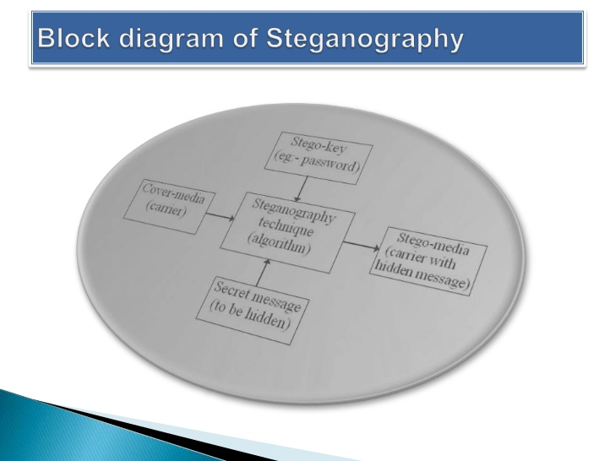

Slide 4
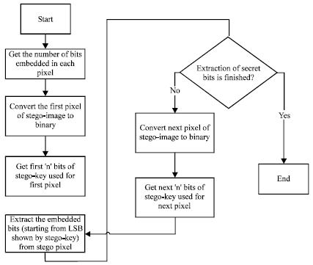
Flowchart for Lsb steganography

Slide 5
Algorithm
Algorithm to embed the text message:-
Step 1: Read the cover image and the text message which is to be hidden in the cover image.
Step 2: Convert the text message in binary format.
Step 3: Calculate the LSB of each pixel of the cover image.
Step 4: Replace the cover image of the LSB with each bit of secret message one by one.
Step 5: Write stego image
Step 6: Calculate the Mean square Error (MSE) and the Peak signal to noise ratio (PSNR) of the stego image.
Algorithm to retrieve text message:-
Step 1: Read the stego image.
Step 2: Calculate LSB of each pixels of stego image.
Step 3: Retrieve bits and convert each 8 bit into character.

Slide 6
Encode File
clc
im1 = imread('image.png');
message = fileread('message.txt');
message_binary = reshape(dec2bin(message, 8)', 1, []);
message_size = length(message_binary);
[l,w,b] = size(im1);
cover_size = l*w*b
if (message_size > cover_size)
disp('Message too large for image.');
end

Slide 7
Encode File
im2 = im1;
i = 1; j = 1; k=1;
for a = 1 : length(message_binary)
if (k > 3)
k = 1;
j = j + 1;
end
if (j > w)
i = i + 1;
j = 1;
end

Slide 8
Encode File
temp_pixel = dec2bin(im1(i, j, k), 8);
LSB = temp_pixel(8);
SM = message_binary(a);
if (LSB ~= SM)
if (LSB == '1')
im2(i, j, k) = im1(i, j, k) - 1;
else
im2(i, j, k) = im1(i, j, k) + 1;
end
end
k = k + 1;
end

Slide 9
Encode file
imwrite(im2, 'stego.png');
figure;
subplot(1,2,1), imshow(im1), title('Original Image');
subplot(1,2,2), imshow(im2), title('Secret Image');

Slide 10
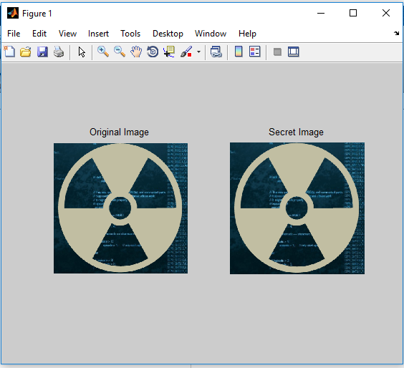
Output- encode file

Slide 11
Decode File
delimiter = '%';
clc
im1 = imread('stego.png');
% figure(1), imshow(im1); title('Original Image');
[l,w,b] = size(im1);
cover_size = l*w*b;
message = '';
char_stream = '';
i = 1; j = 1; k=1;

Slide 12
Decode FIle
while (true)
if (k > 3)
k = 1;
j = j + 1;
end
if (j > w)
i = i + 1;
j = 1;
end
if (i > l)
break;
end

Slide 13
Decode File
temp_pixel = dec2bin(im1(i, j, k), 8);
LSB = temp_pixel(8);
char_stream = strcat(char_stream, num2str(LSB));
if length(char_stream) == 8
new_char = char(bin2dec(char_stream));
message = horzcat(message, new_char);
if (new_char == delimiter)
break;
end
char_stream = '';
end
k = k + 1;
end

Slide 14
Decode FILE
secret_file = fopen('secret.txt','wb');
fwrite(secret_file, message);
fclose(secret_file);
disp(message);

Slide 15
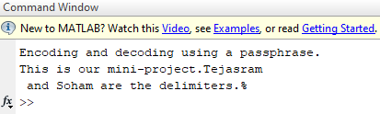
Output- Decode file

Slide 16
APPLICATIONS
Smart ID where data is embedded in the picture of the person
Media data base system
Confidentional communication and secret data storing.
Protection of data alteration
In modern printer

Slide 17
References
https://www.mathworks.com/matlabcentral/fileexchange/41326-steganography-using-lsb-substitution
Research paper by Rahul Joshi, Lokesh Gagani, Saloney pandey. Published in IJARCET
http://ijarcet.org/wp-content/uploads/IJARCET-VOL-2-ISSUE-1-228-229.pdf
Research paper by Champakamala .B.S, Padmini.K, Radhika .D. K . Published in IJACT
http://ijact.org/volume3issue4/IJ0340004.pdf

